Slide 1

Mu2e: Never Say Never
Mariel Pettee
Yale University
Eric Prebys
Fermilab

Slide 2


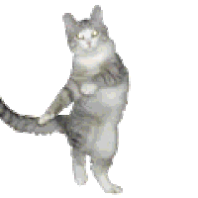
The Mu2e Experiment
Mariel Pettee
Yale University
Mew to E?

Slide 3
Mu2e = Muons (𝜇) to Electrons (𝑒)
𝜇⁻
𝑒⁻
Notes:
I will get

Slide 4
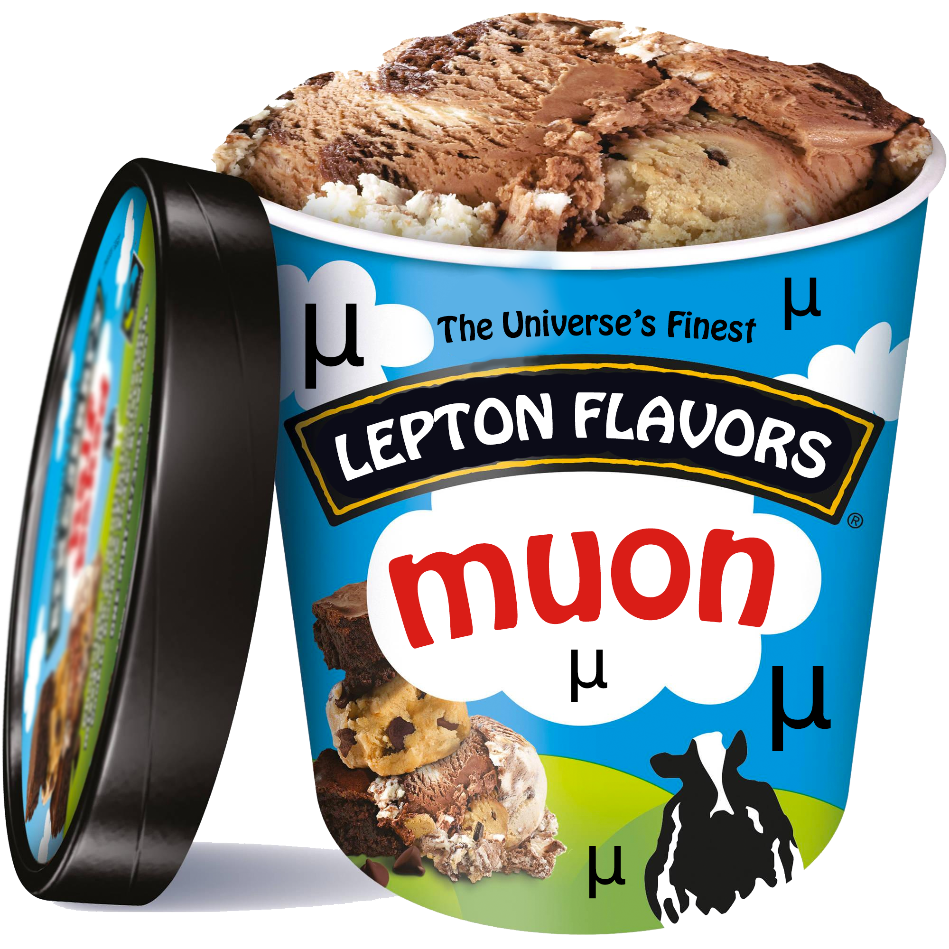
Notes:
I will get

Slide 5
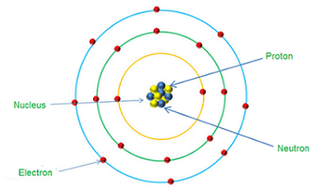
Electrons an muons
𝜇⁻
mass of
𝑒⁻
=~200 x mass of
𝑒⁻
Notes:
I will get

Slide 6
Leptons in the Standard Model
𝑒⁻
𝜇⁻
𝜏⁻
Electron
Muon
Tau
n𝑒
nm
nt
𝑒 Neutrino
𝜇 Neutrino
𝜏 Neutrino
Notes:
I will get

Slide 7
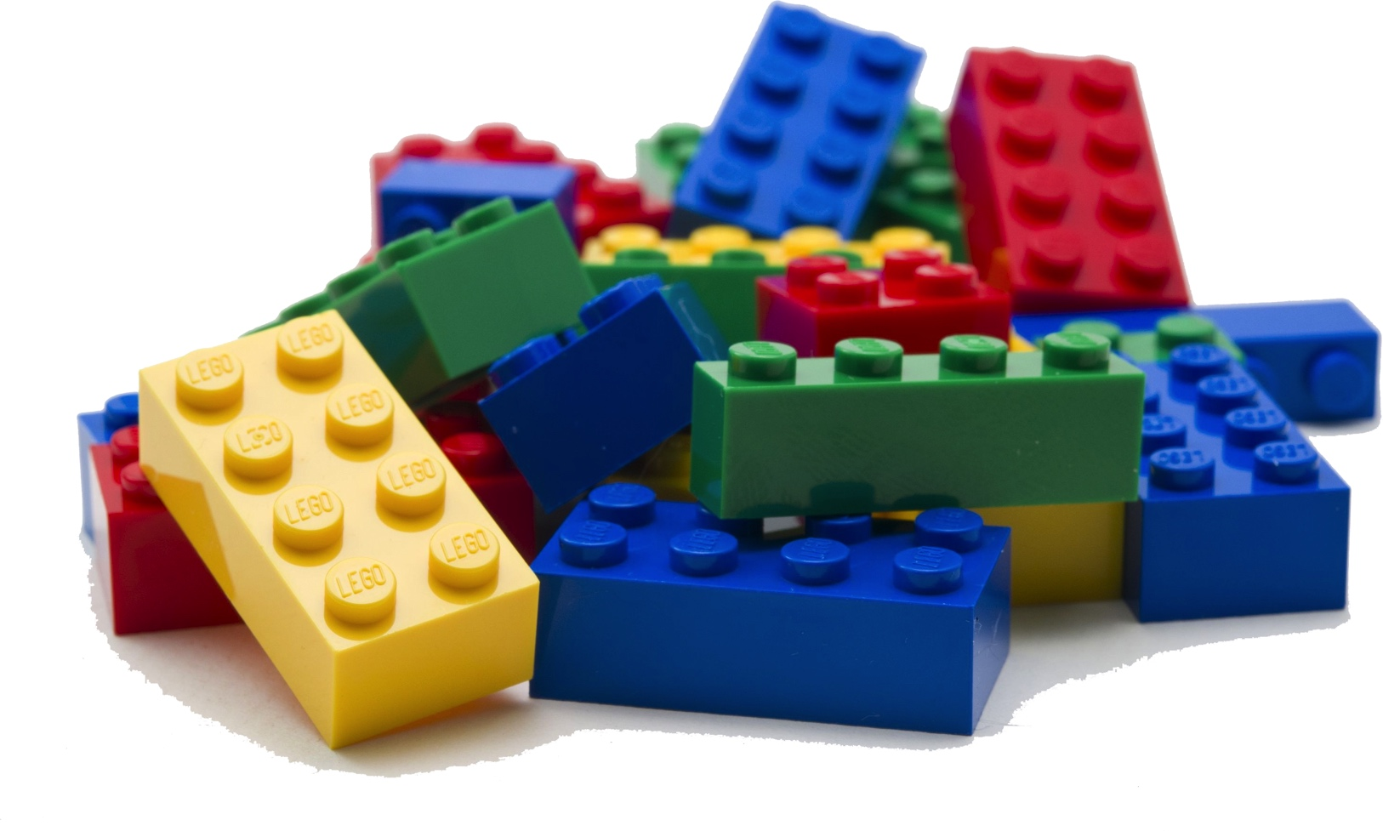
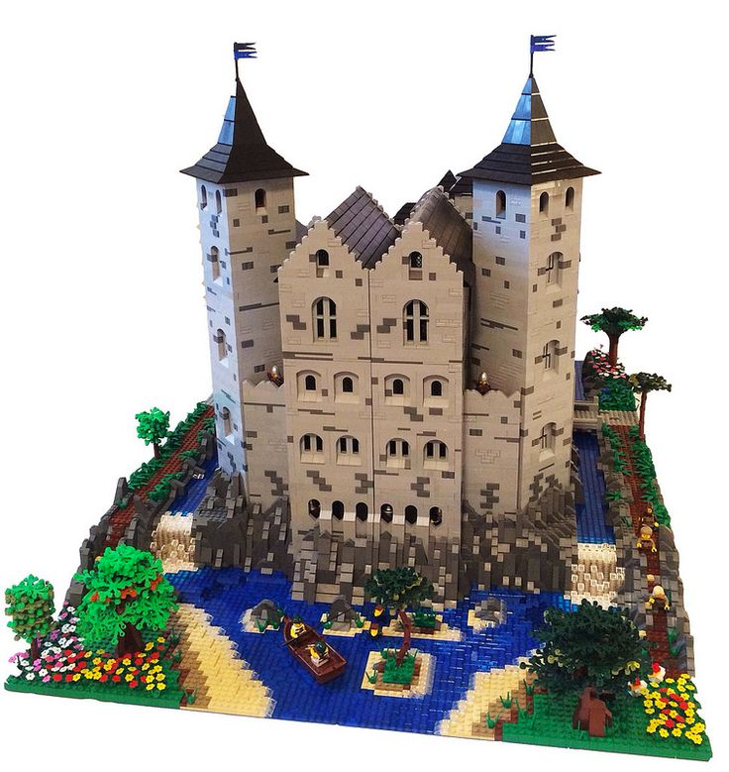
Fundamental
Particles
The Universe

Slide 8
Old News:
n𝑒
𝜇⁻
𝑒⁻
n𝜇

Slide 9
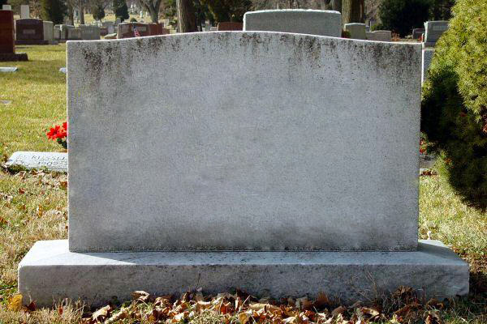
RIP
muon
survived by an electron
and two neutrinos

Slide 10
Old News:
n𝑒
𝜇⁻
𝑒⁻
n𝜇

Slide 11
A new discovery?
𝜇⁻
𝑒⁻

Slide 12
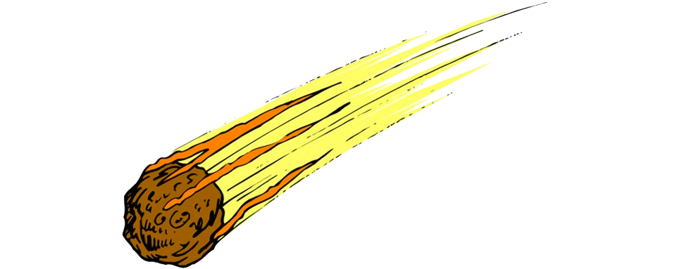


It’s not gonna happen.

Slide 13
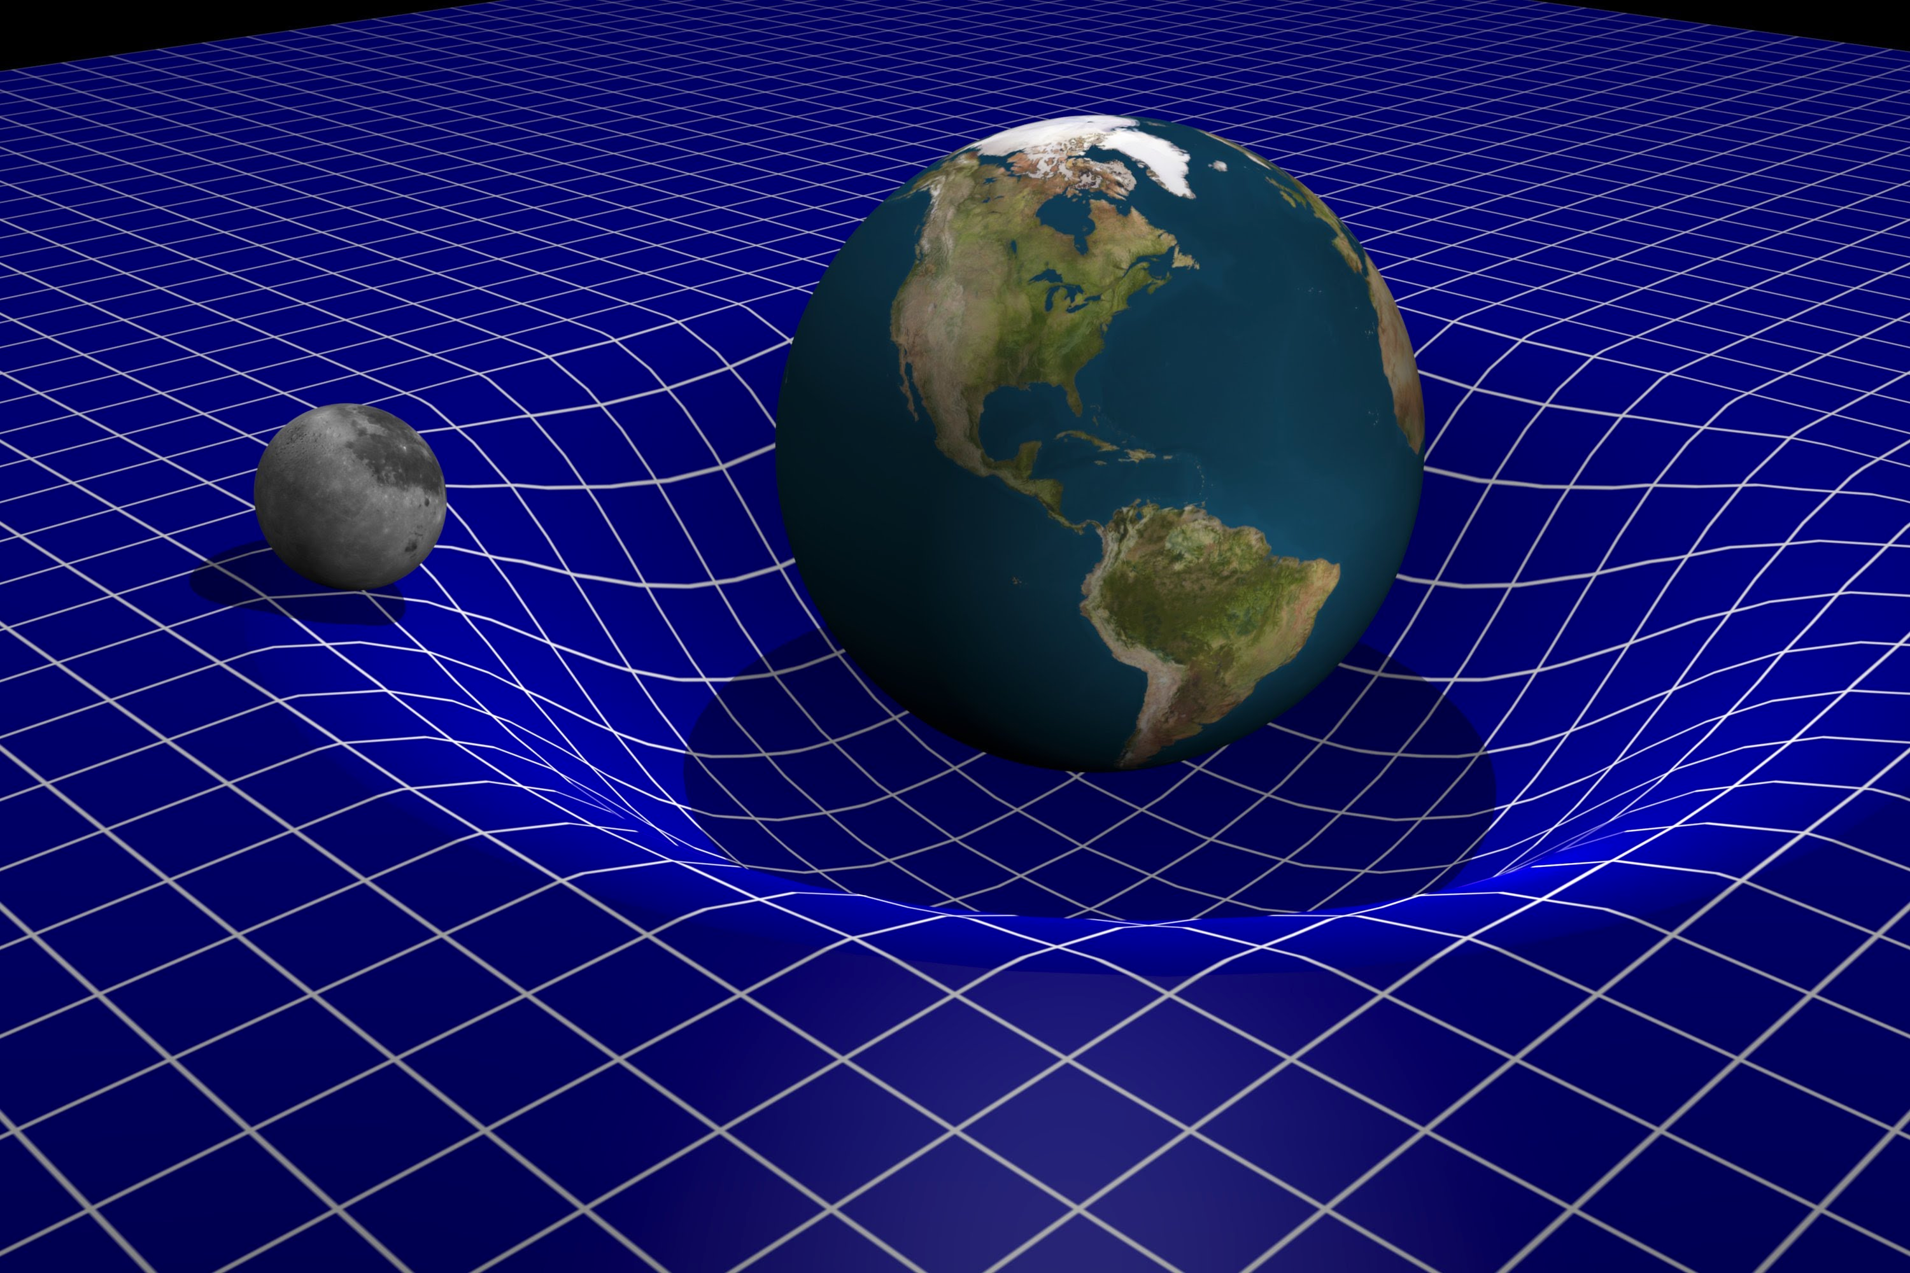
gravity? Dark matter?
Dark matter? Gravity?

Slide 14
The Elusive Neutrino
neutrino
One Light Year of Lead
Notes:
Tony, I would have the electron on both sides exit along the same trajectory, but the electron on the left should move faster than the electron on the right. The neutrinos can both exit towards the top at a speed that’s similar to the electron on the left.

Slide 15

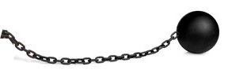
𝜇⁻

Slide 16
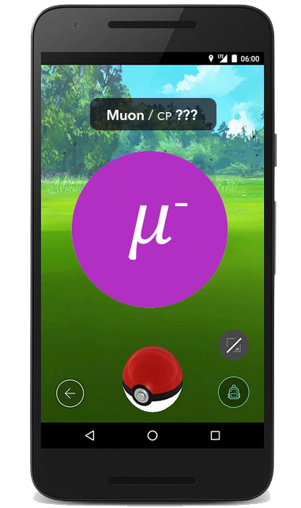

Note: Replace Pokemon Go with something about Cubs

Slide 17
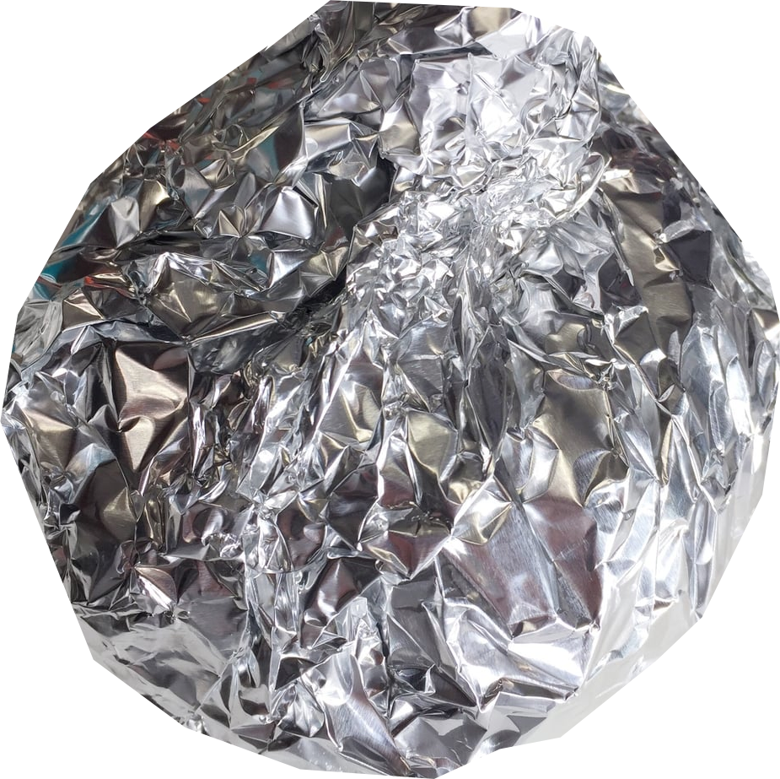
𝜇⁻
𝜇⁻
𝜇⁻
𝜇⁻

Slide 18
E=mc²
^{E = energy}
^{m = mass}
^{c = speed of light}
Energy before = Energy after

Slide 19
Electron Energy = 105 MeV
Electron Energy < 53 MeV
𝑒⁻
n𝜇
𝜇⁻
𝜇⁻
𝑒⁻
𝑒⁻
n𝑒
Energy of electron equals energy of muon
Energy of muon divided among electron and neutrinos
Notes:
Tony, I would have the electron on both sides exit along the same trajectory, but the electron on the left should move faster than the electron on the right. The neutrinos can both exit towards the top at a speed that’s similar to the electron on the left.

Slide 20
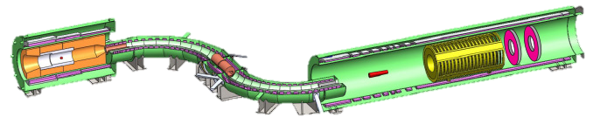
The Mu2e Detector
protons
electrons
Aluminum
muons
~75 feet long (and 6 feet tall)
Notes:
Tony, if it’s not too much trouble, you could animate the next few slides. Start with this one. Then have the protons come in, then have the muons spiral down the s-shaped piece and stop at the red cylinder on the right, and then have electrons spiral from the red cylinder through the detector.

Slide 21
One Quintillion Muons
10¹⁸
(a billion billion)
=
1,000,000,000,000,000,000

Slide 22

One Quintillion Muons…
1 muon for each grain of sand on All the earth’s beaches

Slide 23

Old Result
In 2006, the Sindrum-II experiment announced that muons convert to electrons less than one in a trillion (1000000000000) times.
That’s roughly the chance that your house will be hit by a meteor
Today!

Slide 24
Our Goal
Our goal is to increase the sensitivity by a factor of 10,000, so we will see muon to electron conversion if it occurs one out of ten quadrillion (10000000000000000) times
That’s the chance that your house will be hit by a meteor.
In the next 10 seconds!

Slide 25
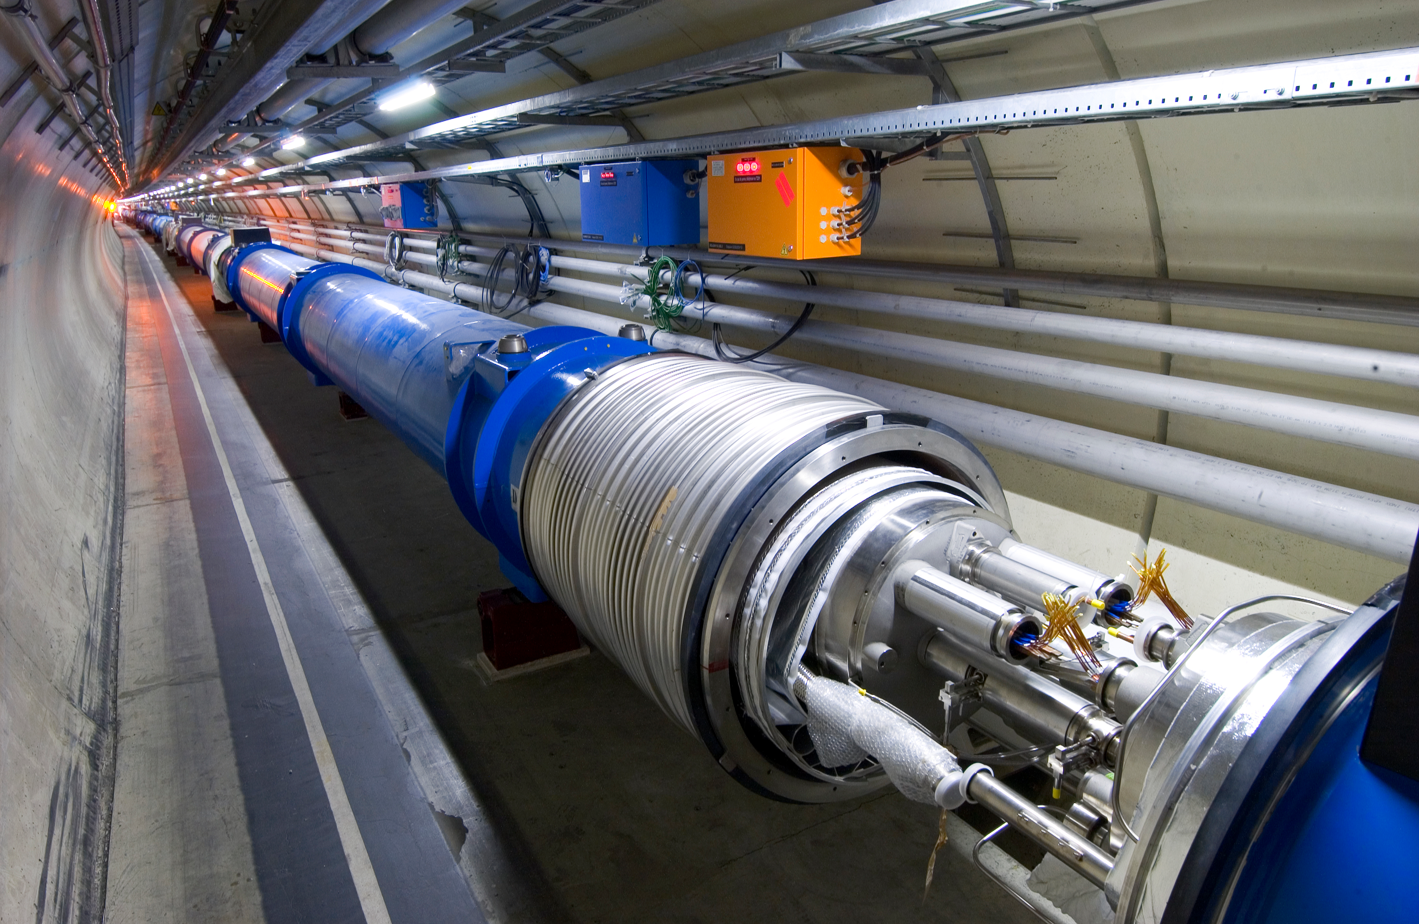
is this the same as the lhc?

Slide 26

you don’t need to be big
to be powerful!
=

Slide 27


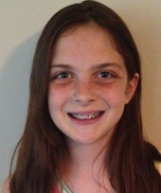

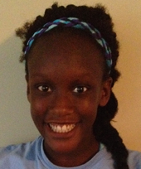
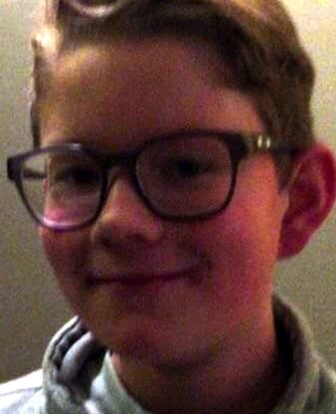


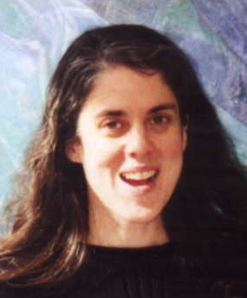

x
Thank you!
Sofia
Liana
Tessa
Danielle
Alexa
Nolan
Emerson
Eric
Mary Anne
Tony

